Slide 1
Choosing the best process and form
Chapter 6
Md. Al-Amin

Slide 2
Learning Outcomes
The significance of skillful writing
The process of writing
How to write letters
How to write memorandums
How to write e-mails

Slide 3
The significance of skillful writing
Writing skill appears ahead of other communication skills
Strong writing skill is required in order to get the promotion
Writing is relatively more difficult than other sorts of communication
Capturing a complex reality by putting one word after another requires ingenuity and discipline.

Slide 4
The Process of Writing

Slide 5
The process of writing (cont.)
The three stages are not strictly chronological or separate
Blend the stages as necessary
Spend a third of your writing time in each of the stage.
Make the format easily readable for your reader.
The writer is responsible for making the important formatting decision.

Slide 6
Main Types of Business Messages

Slide 7
Letters
Letters are the oldest form of communication.
Previous letters focused more on techniques of courtesy.
Current emphasis is on strategy and humanness.

Slide 8
Business Letter Template
Date: Use month, day, year format, e.g., March 3, 2012 or 3 March 2012
Sender's Address: It is a good idea to include sender's email and url, if available. Don't include this information if it's already incorporated into the letterhead design. This will allow customers to find your small business more quickly.
Inside Address: Use full name. Mr./Miss/Mrs is optional
Salutation: Dear Mr. Andrew. Be sure to use a colon at the end of the name, not a comma as in personal letters

Slide 9
Business Letter Template (cont.)
Body Text: State why you are writing. Establish any connection/mutual relationship up front. Outline the solution, providing proof in the way of examples and expert opinions. Group related information into paragraphs
Closing "Call to Action": State what the reader needs to do and what you will do to follow up
Signature Block: Sign your letter in blue or black ink
Enclosures: Use if you have an enclosure

Slide 10
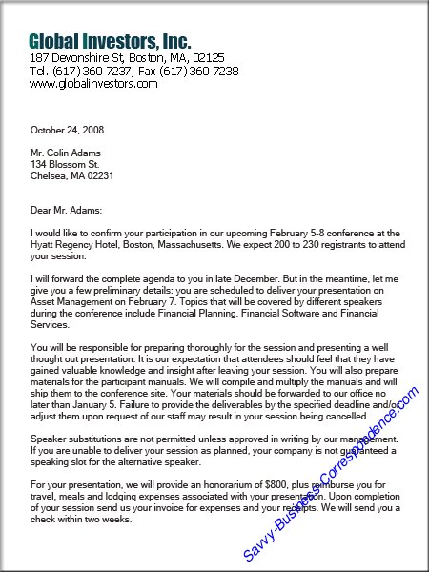

Slide 11
Memorandums
Memos are internal letters.
It is used as a short proposal. Should not exceed one page.
Memos are sent to co-workers and colleagues.
They are more informal and do not require a closure statement like business messages.
Do not use memos for a lot of information. Some memos may be classified as reports.
Some large companies have additional headings.

Slide 12
Memo format: Sample
Memo: sometimes the word Memo appears at the top
TO: recipients’ names and job titles
FROM: writer’s name and job title
DATE:
SUBJECT: description of what the memo is about.
First sentence: reason for the memo.
Second sentence: any instructions or information.
Closing sentence: what is required of the reader (confirmation, answers or feedback)
(message should be single spaced)

Slide 13
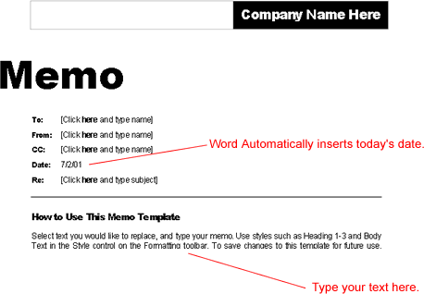
Memo Format

Slide 14
Email
Explosive recent growth
And the growth to continue
Make sure you have a formal and neutral e-mail addresses, ideally consisted of first and last name

Slide 15
Terrible E-mail Addresses
Brokenheart.hridoy@gmail.com
Sweetgirl.samina@gmail.com
Rudestgirl007@gmail.com
DavidAtHotmailDotComIMeanYahooDotCom@yahoo.com
Santacloss_6@yahoo.com
kingofleon1987@hotmail.com

Slide 16
Structure of Email
Standardized elements
To
Cc
Bcc
Subject
Attachments
Salutation
Message (opening, main body, call to action)
Closing

Slide 17
Mistakes people make in email subject lines
Not writing one
Writing too much (More than 6-8 words)
Being too vague (do you have a sec?)
Be clear and specific
Not to place the important element
Using filler words (hello, thanks)
Putting words in ALL CAPS
Using the wrong name
Using illogical words

Slide 18
Formality of Email Writing
Range is from highly formal to highly informal.
Three general writing styles:
Casual
Informal
Formal

Slide 19
Casual Writing—Acceptable Between Acquaintances
Personal contractions, personal pronouns, incomplete sentences, initials and highly informal
Example:
“Hi Smith buddy! Read your super proposal. IMHO, it’s in the bank”.

Slide 20
Informal Writing
Retains some casual qualities (personal pronouns, contractions)
Polished conversation and organized sentences
Corresponds to proper conversation
Example: “I’ve read your excellent proposal. I predict the administrators will approve it.”

Slide 21
Formal Writing
Maintains distance between writer and reader.
Avoids personal references and contractions.
Example: “The proposal is excellent. The executives are likely to approve it.”

Slide 22
General Email Writing Considerations
Conciseness
Make the sentences short—only the essentials.
Use words economically.
Paraphrase previous messages concisely.
Quote selectively.

Slide 23
“Remember not only to say the right thing in the right place, but far more difficult still, to leave unsaid the wrong thing at the tempting moment.”
--Benjamin Franklin

