Slide 1
Human Resources Management
MGT 351
Md. Al-Amin (Mli)

Slide 2
Instructor’s Information
Md. Al-Amin (Mli)
Designation: Sr. Lecturer
Department: Management
Office: NAC 869
Email: md.alamin@northsouth.edu,
m.al-amin.13@aberdeen.ac.uk
Web Address: http://alaminmli.weebly.com

Slide 3
HR: One of the Most Important Resources
Some common resources in the context of an organization are:
Physical Resources
Financial Resources
Market Resources
Technological Resources
Human Resources

Slide 4
Core Functions of HRM
Recruitment
and Selection
Training and Development
Performance
Appraisal
Compensation

Slide 5
Course Objectives
To learn various aspects of basic HRM including terminologies.
To learn how to analyze jobs and the process of selection and recruiting.
To learn the interview techniques and its process.
To learn the basic of compensation design and incentives.
To learn and to get familiar with the benefits options offered in Bangladesh. For example, PF and Gratuity calculation.
Students will learn about public speaking as they demonstrate their debating skill.
Students will learn how to dissect a complicated case and prepare a report professionally.

Slide 6
Assessment
Grading tools | Points
Midterm Exam 1 | 20%
Midterm Exam 2 | 20%
Final Exam | 25%
Report | 10%
Presentation | 10%
Case Study | 10% (2 units)
Attendance/ Participation | 05%

Slide 7
Author | Title | Edition & Year | Publisher | ISBN
Gary Dessler | Human Resources Management | 16th Edition, 2020 | Pearson | ISBN-13: 978-0135637289

Slide 8
Keys to Success
Attend every single class. Please don’t miss a class unless you have a very valid reason.
Take notes. All examples and explanations won’t be available in the slides.
Make sure you understand the lecture. It’s a strategic imperative.
Please do ask me questions if you have confusion over the materials.
See me sooner rather than later if you have problems with the materials.
Study steadily—this is vital, if you want be good at managing people.
Read the relevant chapters from textbook in advance.

Slide 9
Introduce Yourself
It’s time to introduce yourself!

Slide 10
Session 1
Introduction to Human Resources Management

Slide 11
Learning Outcomes
The concept of management and HRM
The importance of HRM
Types of HR managers
Duties of HR managers
Strategic aspect of HRM
SHRM tools

Slide 12
What Is Management?
Management involves coordinating and overseeing the activities of others so that their activities are completed and organizational goals are accomplished
Two important aspects- coordination and observation
Coordinating and overseeing
Employees’ activities are completed
Individual goals are accomplished
Organizational goals are accomplished

Slide 13
Functions of Management
Managing involves 5 functions:
Planning
Organizing
Staffing
Leading
Controlling

Slide 14
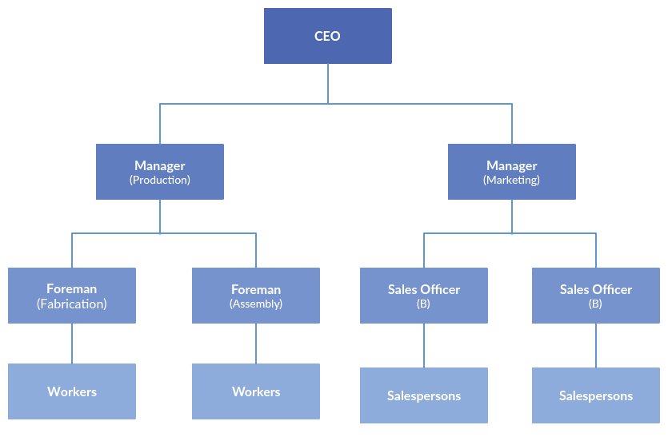
Sample Organizational Chart

Slide 15
Controlling Procedure
Step 1: Review the Goal (e.g., to produce 10 units)
Step 2: Actual Performance VS Standard/ Goal (e.g. 7 units VS 10 units = short of 3 units)
Step 3: Corrective Actions (e.g. Raw material, machineries, T & D)

Slide 16
What Is Human Resources Management
HRM is the process of of acquiring, training, appraising, and compensating employees, and of attending to their labor relations, health, safety, and fairness concerns.

Slide 17
Why Is HRM Very Important?
If you don’t exercise the concepts and techniques of HRM, you might have to:
Hire the wrong person (example of Nissan)
Experience high turnover (example of UK retailers)
Have some employees think their salaries are unfair
Experience employee disengagement
Have an unsafe workplace
Allow a lack of training leading to poor performance

Slide 18
Group Discussion
Form small groups and discuss the importance of Human Resource Management in the context of Bangladeshi organizations
Include at least 5 points
Don’t forget to write down the points as you are required to present them

Slide 19
What kind of manager is an HR manager?
Are they line managers or staff managers?
Line managers have line authority. They can issue orders to other managers or employees.
Staff managers have staff authority. This type of authority enables them to advise other employees or managers.

Slide 20
Human Resource Manager’s Duties
Staff functions:
Assist and advise line managers
HR managers assist in hiring, training, evaluating, rewarding, counseling, promoting, and firing employees
HR administers various benefit programs (e.g. health and accident insurance, retirement, vacation)
They also help other managers comply with equal employment and safety laws and manage workplace grievances

Slide 21
Human Resource Manager’s Duties (Cont.)
A line function:
The human resource managers carry out the line functions as well
They direct the activities of the people in their own department
A coordinative function:
Coordinate human resource activities
Ensuring that the line managers are implementing the firm’s HR policies and practices

Slide 22
Strategic Aspect of HRM
Strategic Human Resources Management (SHRM) involves formulating and executing human resource policies and practices that produce the employee competencies and behaviors the company needs to achieve the strategic aims.
SHRM aligns HR practices with organizational strategic goals
http://www.cipd.co.uk/hr-resources/factsheets/strategic-human-resource-management.aspx

Slide 23
SHRM (Cont.)
HR Policies and Skills:
1. R & S
2. T & D
3. Appraisal
4. Compensation
Competencies and Behavior
Goal Attainment

Slide 24
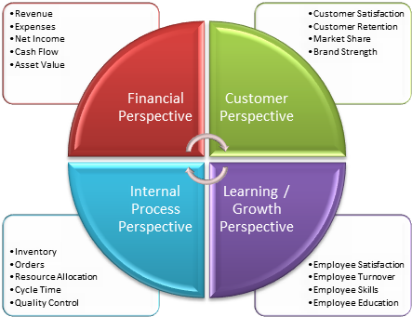
SHRM Tools
Balance Score Card

Slide 25
HRM Tools

Slide 26
“You don’t build a business, you build a people and then people build the business”- Zig Ziglar

