Slide 1
Introduction to Labor Management Relations
Lecture 1& 2

Slide 2
Meaning & Concept
Labor-management relation explains the relationship between employees and management stems directly or indirectly from the union-employer relationship.
The relationships which arise at and out of the workplace generally include the relationships between individual workers, the relationships between workers and their employer, the relationships between employers, the relationships employers and workers have with the organizations formed to promote their respective interests, and the relations between those organizations, at all levels.
Labor-management relation has a broad as well as a narrow outlook. Originally, labor-management relations were broadly defined to include the relationships and interactions between employers and employees

Slide 3
Definitions
1. The term labor-management relations, also known as Industrial Relations (IR), refers to the system in which employers, workers, and their representatives and, directly or indirectly, the government interact to set the ground rules for the governance of work relationships.
2. Employer-employee relationships that are covered specifically under collective bargaining and industrial relation laws.

Slide 5
OBJECTIVES OF IR
Employee empowerment: provide an opportunity to the workers to participate in management and decision making process.
Productivity: raise productivity in the organization to curb the employee turnover and absenteeism.
Bargaining capacity: to improve the bargaining capacity of the workers through trade unions.
Discipline: to ensure discipline in the organization and in the industry.

Slide 6
OBJECTIVES OF IR
Labor-management interest: to safeguard the interests of the labor and the management by preventing one of the players from getting a strong hold over the other.
Mutual cooperation: to develop & Secure mutual understanding & good relationships among all the players in the industrial set-up.
Resolve and preventing industrial conflict: to maintain industrial peace & harmony by preventing industrial conflicts.

Slide 7
OBJECTIVES OF IR
Economic condition: improvement of economic conditions of workers.
Standard of living: to improve the standard of living of the average worker by providing basic and standard amenities.
Basic framework: to provide a basic framework for the management & the employees to resolve their differences.

Slide 8
Approaches to IR
There are mainly three approaches to IR
1. Unitary approach
2. Pluralistic Approach
3. Marxist Approach
4. Systems Approach

Slide 10
1.Unitary Approach
IR is grounded in mutual co-operation, individual treatment, team work and shared goals.
Union co-operate with the mgt. & the mgt.’s right to manage is accepted because there is no „ we they feeling‟
Assumption: Common interest & promotion of harmony
No strikes are there.
It's a reactive IR strategy.
They seek direct negotiations with employees.

Slide 11
2.Pluralistic Approach
It perceives:
• Org. as a coalitions of competing interest.
• TU as legitimate representatives of employee interests.
• Stability in IR as the product of concessions and
compromises between mgt. & unions.
Conflict between Mgt. and workers is understood as
inevitable.
Conflict is viewed as conducive for innovation and
growth.
Strong union is necessary.

Slide 12
3.Marxist Approach
Regard conflict as Pluralists…
Marxists see conflict as a product of the capitalist society.
Conflict arises due to the division in the society between those
who own resources and those who have only labor to offer.
For Marxist all strikes are political.
He regard state intervention via legislation & the creation of
Industrial tribunals as supporting mgt’s interest rather than
ensuring a balance between the competing groups.

Slide 13
4.Systems approach
The system approach was developed by Dunlop of Harvard University in 1958.
According to this approach, individuals are part of an ongoing but independent social system.
The behavior, actions and role of the individuals are shaped by the cultures of the society.
The three elements of the system approach are input, process and output.
Society provides the cue (signal) to the individuals about how one should act in a situation.

Slide 14
Systems approach
• The institutions, the value system and other characteristics of the society influence the process and determine the outcome or response of the individuals. The basis of this theory is that group cohesiveness is provided by the common ideology shaped by the societal factors.

Slide 15
Dunlop’s Systems Approach
PROCESSES
Bargaining
Conciliation
Arbitration
Adjudication
Legislation
INPUTS
Actors
(Employees, Employers,
State)
Context
(Tech, Market, Power
Indeology)
OUTPUT
Rules
Feedback

Slide 16
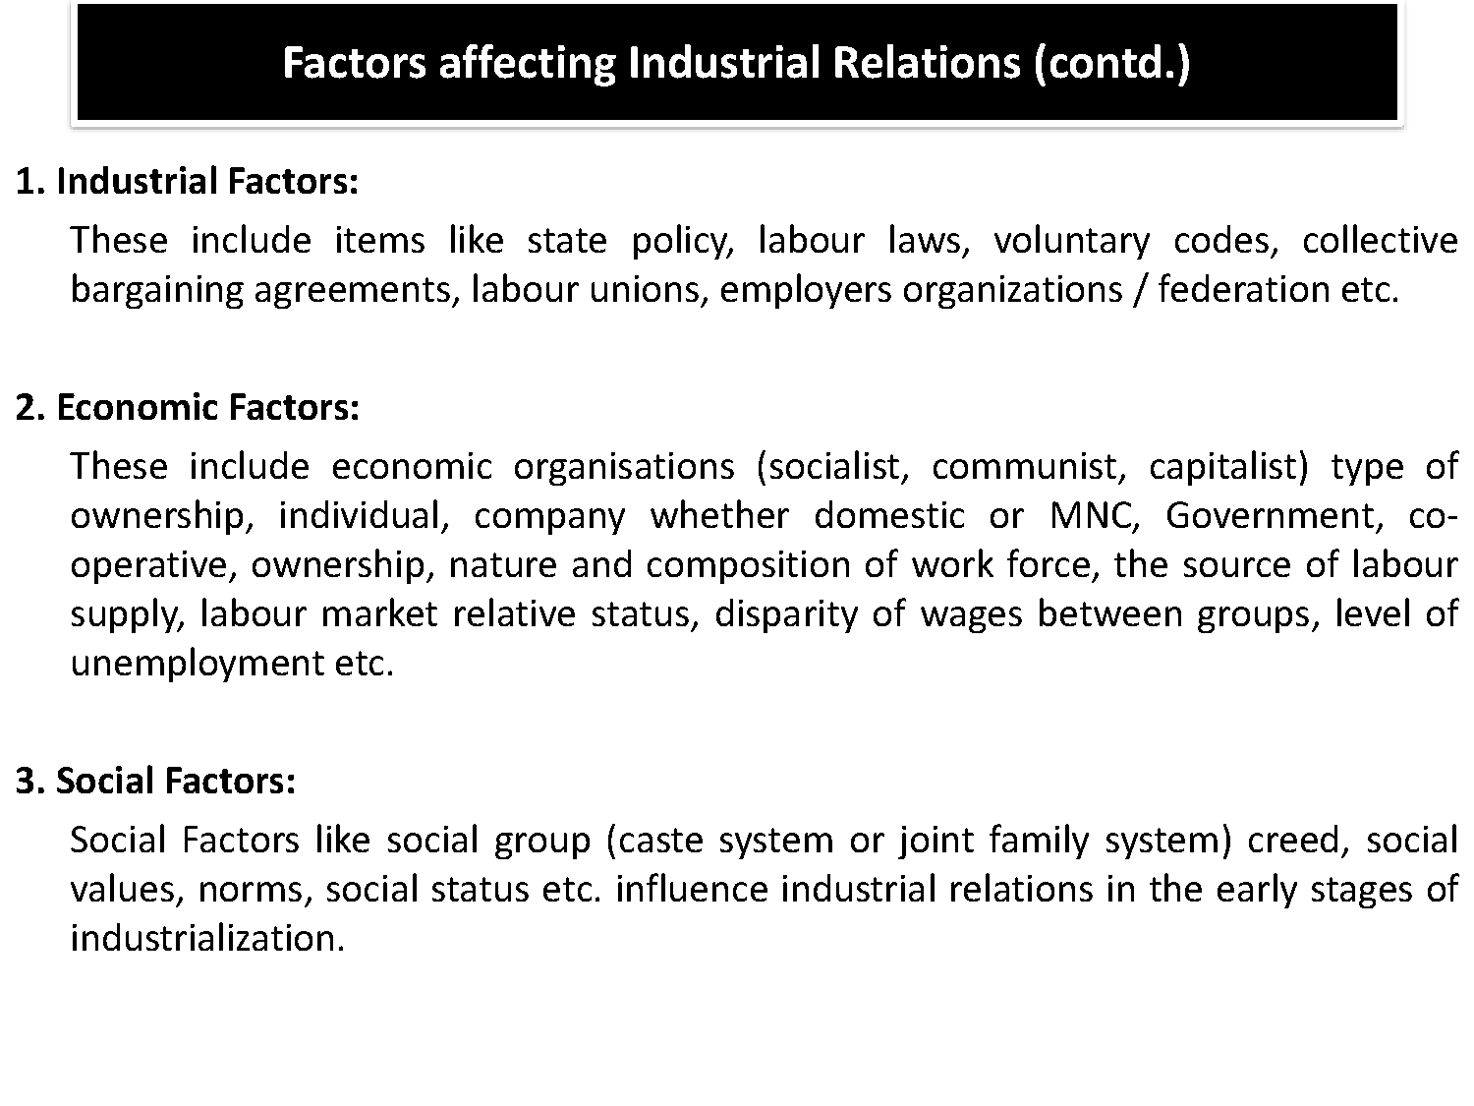

Slide 18
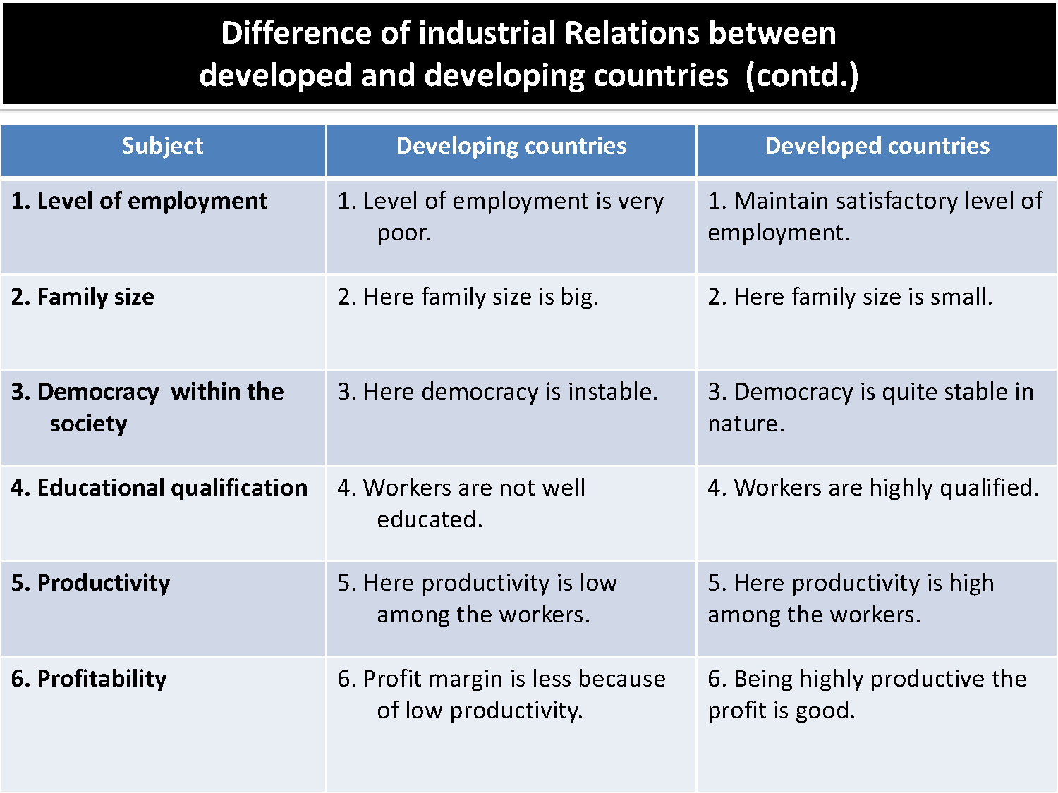

Slide 20
Causes of poor IR
The main reasons are as follows:
An attitude of contempt towards the workers on the part of the management.
Lack of emotional intelligence on the part of the management.
Inadequate fixation of wages or improper wages.
Unhealthy working conditions at the workplace.
Desire of workers for higher bonus, wages or daily allowances.
Desire of employers to pay as little as possible to its workers.
Lack of human relations skills on the part of supervisors and managers.

Slide 21
Causes of poor IR
· Inadequate welfare facilities.
· Dispute on sharing the gains of productivity.
· Retrenchment, dismissal, and lockouts by the management.
Strikes by the workers.
Inter-union rivals.
· General economic and political environments such as rising prices, strikes by others, and general indiscipline that affect the employees’ attitudes.
Mental inertia on the part of the management.

Slide 22
Assess your Emotional Intelligence: The brain dominance test
Left-brained | Right-brained
Logical | Emotional
Analytical | Thoughtful
Objective | Subjective
Critical thinking | Creative
Numbers | Intuition

Slide 24
3 Actors of IR
1
EMPLOYEES
2
STATE
3
EMPLOYER

Slide 25
Role of Three Actors to IR
Role of EMPLOYEES
To redress the bargaining advantage on one-to-one basis
·
To secure better terms and conditions for their members
· To obtain improved status for the worker in his/her work
· To increase implementation of democratic way of decision making at various levels

Slide 26
Role of Three Actors to IR
Role of EMPLOYERS Contd.
· Creating and sustaining employee motivation
· Ensuring commitment from employees
· Negotiating terms and conditions of employment with TU leaders
· Sharing decision making with employees

Slide 27
Role of Three Actors to IR
Role of STATE
· Labor policies
· Labor laws
· Industrial tribunals
· Wage boards
· Industrial relations policy

Slide 28
“You don’t build a business, you build people and then people build the business”- Zig Ziglar

