Slide 1
Chapter Five: Wages

Slide 2
Basic Factors
Employee compensation
All forms of pay or rewards going to employees and arising from their employment.
Direct financial payments
Pay in the form of wages, salaries, incentives, commissions, and bonuses.
Indirect financial payments
Pay in the form of financial benefits such as insurance.

Slide 3
Establishing Pay Rates
Step 1. The salary survey
It is difficult to set pay rates if you don’t know what other are paying.
Aimed at determining current wage rates at other companies
A good salary survey provides specific wage rates for specific jobs.

Slide 4
Sources for Salary Surveys
Formal written questionnaire surveys are the most comprehensive, but telephone surveys, internet surveys and newspaper ads are also sources of information.
Consulting firms
Professional associations
Government agencies

Slide 5
Establishing Pay Rates (cont.)
Step 2. Job evaluation
A systematic comparison done in order to determine the worth of one job relative to another.
Compensable factor
A fundamental, compensable element of a job, such as skills, effort, responsibility, and working conditions.

Slide 6
Job Evaluation Methods: Ranking
Ranking each job relative to all other jobs, usually based on some overall factor.
Steps in job ranking:
Obtain job information.
Select and group jobs.
Select compensable factors.
Rank jobs.
Combine ratings.

Slide 7
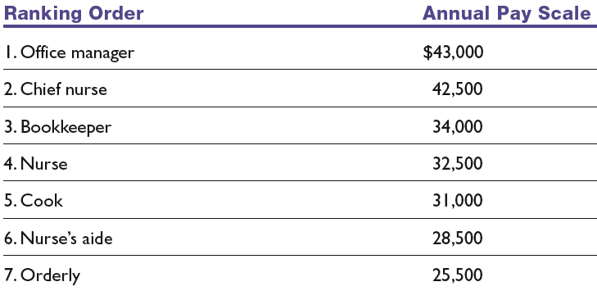
Job Ranking by Olympia Health Care

Slide 8
Pros and Cons of Ranking Method
PROS:
The method is comparatively simple, easily understandable, and mostly acceptable by labor unions.
It is suitable for comparatively smaller organizations which may not like to undertake more laborious exercises.
The method is less costly to undertake and maintain as compared to other systems.

Slide 9
Pros and Cons of Ranking Method
CONS:
Ranking method is judgmental and non-analytical, therefore, it is affected by personal preferences of job evaluators.
This method ranks various jobs in order of their relative worth. It does not specify the real difference between two jobs. For example, the exact difference between job ranked at first and the job ranked at second cannot be specified.

Slide 10
Job Evaluation Methods: Classification or Grading
A predetermined number of job groups or job classes are established and jobs are assigned to these classification.
Steps in job ranking:
Class I – Executives (e.g. Office Manager, Deputy Office Manager, Departmental Supervisor)
Class II – Skilled workers (e.g. Purchasing Assistant, Cashier, Receipts Clerk)
Class III – Semiskilled workers (e.g. Machine Operators, Switchboard Operators)
Class IV – Unskilled workers (e.g. Peons, Housekeepers, File Clerks, Office Boys)

Slide 11
Pros and Cons of Classification Method
PROS:
It is quite simple to operate and understand as the relevant information is provided by job analysis which serves other purposes too.
Job evaluation done on grading method makes wage determination easier easier as these are fixed in terms of various grades of jobs.

Slide 12
Pros and Cons of Classification Method
CONS:
Job grade description is vague and personal biases may distort job grading as the method is not based on any scientific analysis..
There are chances of employees’ resistance when new clusters of jobs are prepared.

Slide 13
Job Evaluation Methods: Factor Comparison
It’s widely used and is considered to be one of the reliable and systematic approach for job evaluation.
Select the factors- Identify the key factors common to all the identified jobs such as skill, effort, responsibility).
Divide each major factor into a number of sub factors.
Find the maximum number of points assigned to each job
Convert the points into money value

Slide 14
Pros and Cons of Classification Method
PROS:
It provides more accurate information about the relative worth of a job as different comparable factors are compared with key jobs.
Since only limited number of factors relevant for the effective job performance are compared, there are reduced chances of overlapping.
Since the evaluation is more systematic and analytical, its logic can be accepted by trade unions and workers..

Slide 15
Pros and Cons of Classification Method
CONS:
This method is quite costly and time consuming to install and difficult to understand.
This system considers only limited factors of job for comparison. This may be a positive point so far as avoidance of duplication and simplicity of procedure are concerned, but may ignore other factors which may be important for the performance of the job.
If wage rates are adopted for making comparison, the system may become invalid very soon as there may not be proportionate increase in wages for all jobs.

Slide 16
Establishing Pay Rates (cont’d)
Step 3. Price Each Pay Grade — Wage Curve
Shows the relationships between the value of the job as determined by one of the job evaluation methods and the current average pay rates for your grades.

Slide 17
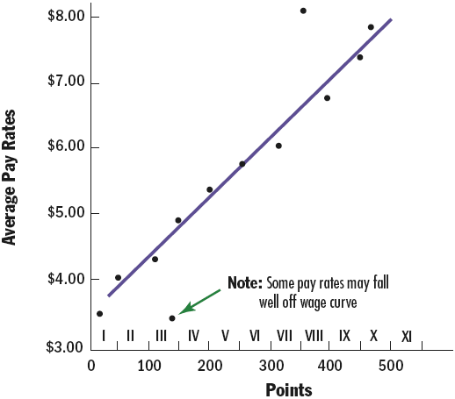
Plotting a Wage Curve

Slide 18
Establishing Pay Rates (cont’d)
Step 4. Fine-tune pay rates
Developing pay ranges
Flexibility in meeting external job market rates
Easier for employees to move into higher pay grades
Allows for rewarding performance differences and seniority
Correcting out-of-line rates
Raising underpaid jobs to the minimum of the rate range for their pay grade.
Freezing rates or cutting pay rates for overpaid (“red circle”) jobs to maximum in the pay range for their pay grade.

Slide 19
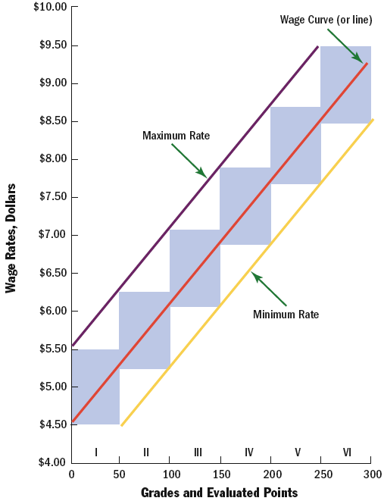
Wage Structure
Note: This shows overlapping wage classes and maximum–minimum wage ranges.
Figure 11–5

Slide 20
Compensating Expatriates
The “Balance Sheet Approach”
Home-country groups of expenses—income taxes, housing, goods and services, and discretionary expenses—are the focus of attention.
The employer estimates what each of these four expenses is in the expatriate’s home country, and what each will be in the host country.
The employer then pays any differences such as additional income taxes or housing expenses.

Slide 21
The Balance Sheet Approach
Items | Bangladesh | UK | Alloowances
Basic Salary | £24,000 | £24,000 | £0.00
Expenses:
1. Housing & Utilities | £7000 | £24,000 | £17000
2. Goods & Services | £2000 | £6000 | £4000
3. Taxes | £4000 | £7000 | £3000
4. Discretionary Income | £4000 | £6000 | £2000
Total |  |  | £26000

Slide 22
The Balance Sheet Approach (Cont.) (Assumes Base Salary of $80,000)

Slide 23
Incentives
Hardship allowances
Payments to compensate expatriates for exceptionally hard living and working conditions at certain foreign locations.
Mobility premiums
Lump-sum payments to reward employees for moving from one assignment to another.
Foreign service premiums
Financial payments over and above regular base pay, and typically range between 10% and 30% of base pay.

Slide 24
Why Expatriate Assignments Fail
Personality
Personal intentions
Family pressures
Inability of the spouse to adjust
Inability to cope with larger overseas responsibility.
Lack of cultural skills

Slide 25
Helping Expatriate Assignment Succeed
Careful adaptability screening
Providing realistic previews of what to expect
Improved orientation
Cultural and language training
Improved compensation packages

Slide 26
The Origin of Pay for Performance
In the 1800s, Fredrick Taylor popularized using financial incentives
Taylor had a feeling that the employees had the tendency to work at the slowest pace and and to produce at the minimum acceptable level
Such attitudes of employees was referred to as systematic soldiering by Taylor
To overcome the problem, Taylor established the connection between pay and performance level
He provided the incentives to the workers whose production exceeds predetermined standard

Slide 27
Linking Performance and Pay
Today, it is a strategic imperative to link the performance to pay
However, it is not an easy task and many pay for performance programs are ineffective
Research shows that 83% of such programs are somewhat successful or not successful
To establish effective programs, it is essential to understand the incentive theories and strategies

Slide 28
Motivation Theories: The Hierarchy Needs of Abraham Maslow
Self-actualization
Self-esteem
Social Needs
Security
Physiological Needs

Slide 29
Practical Implication of Maslow’s Theory
Any guesses????????
Discuss with your neighbor!

Slide 30
Practical Implication of Maslow’s Theory
People are motivated first to satisfy the lower-order needs
Don’t try to motivate a person with a higher position who doesn’t have enough money to pay the bill

Slide 31
Motivation Theories: Motivators and Fredrick Herzberg
Hygiene factors (extrinsic factors) | Motivators (intrinsic factors)
Better pay and working condition | Recognition, appreciation and providing challenging work
These factors just keep the employees from becoming dissatisfied | The best way to motivate a person is to provide with motivator factors
Adding more of these factors will not generate extra motivation for the employees | Adding more of these factors will enrich the job and get the employees further motivated

Slide 32
Practical Implication of Herzberg’s Theory
Any Guesses???

Slide 33
Practical Implication of Herzberg’s Theory
Relying exclusively on extrinsic factors is risky
Incentive plan should include the intrinsic factors along with extrinsic factors

Slide 34
Motivation Theories: Expectancy Theory and Victor Vroom
Vroom’s Expectancy Theory
A person’s motivation to exert some level of effort is a function of three things:
Expectancy: that effort will lead to performance.
Instrumentality: the connection between performance and the appropriate reward.
Valence: the value the person places on the reward.
Motivation = E x I x V
If any factor (E, I, or V) is zero, then there is no motivation to work toward the reward.
Employee confidence building and training, accurate appraisals, and knowledge of workers’ desired rewards can increase employee motivation.

Slide 35
Wage Structure in Bangladesh
The main objective of fixing wage structure is to pay the labourers a minimum amount with which they can meet their needs.
In Bangladesh there is no uniform minimum wages for workers across all sectors.
Any homogeneity between minimum wages fixed for different sectors and industries is also absent
Different wage structures prevail in different industries that are relevant to the job pattern of the workers.
Several wage boards have been set up at different times with the aim to fix minimum wages for workers employed in various enterprises- public and private.
This chapter will encompass the existing minimum wage structure in major industries and sectors in Bangladesh and will also cover existing legal mechanisms, the socio-economic conditions of Bangladesh and other relevant issues.

Slide 36
Legal Framework for ‘wage’ and ‘minimum wage’
Payment and protection of wages and other related matters were previously regulated by the Payment of Wages Act, 1936.
Payment of Wages Act had a wide coverage.
Workers employed in factories, shops, industrial and commercial establishments like road transport services, railways, dock, jetty, inland steam vessel, mine, oil field, plantation or any other workshop have been brought within the purview of this legislation.
This Act has now been merged with the newly introduced Labour Act 2006 with some modifications.
According to S.2(45) of the Act, ‘wages’ refer all remuneration capable of being expressed in terms of money
It is payable to a worker if the terms of the contract of employment are fulfilled.

Slide 37
Legal Framework for ‘wage’ and ‘minimum wage’
The term ‘wages’ does not include the following:
the value of any house accommodation, supply of light, water, medical attendance or other amenity or a\of any service excluded by general or special order of the Government;
any contribution paid by the employment to any pension fund or provident fund ;
any travelling allowance or the value of any travelling concession
any sum paid to the person employed to defray special expenses entailed on him by the nature of his employment.
However, according to section 120, the phrase ‘wages’ shall include the following, namely:
any bonus or other additional remuneration payable as per the terms of employment;
any compensation payable for holiday, stoppage or overtime work;
any remuneration payable for any order of the court or for any award or resolution between the parties;
any money payable under any contract or the Labour Act for any removal from service- be it under retrenchment, discharge, removal, resignation, retirement, dismissal;
money payable for lay-off or temporary dismissal.

Slide 38
Legal Framework for ‘wage’ and ‘minimum wage’
According to the ILO Convention 131, the right to minimum wages must be ensured by law and it cannot be left to anybody’s discretion.
Actions have to be taken against those who fail to implement the law
Under the Bangladesh Labour Act 2006, the minimum rate of wages fixed by the Government is final and cannot be questioned by any person in any manner in any court or authority.
The rates declared by the Government on the recommendations of the Board are minimum rates of wages and no employer can pay wages lower than those notified by the Government.
However, the law does not preclude employers from paying more than what has been recommended

Slide 39
Determination of Minimum Wages
Generally wages are specified in three ways:
first, through negotiation between employers and the employees
second, laws laid down by the government
third, through agreement between the trade unions and the employers
In Bangladesh, wages are determined by three separate bodies.
Wages for government employees are fixed up by National Pay Commission(NPC) that announces new pay scales every five or six years
Wages and related benefits for workers in the public sector enterprises are determined from time to time through recommendation of the National Workers’ Wages and Productivity Commission (Popularly known as Wages and Productivity Commission, WPC) established under the State-Owned Manufacturing Industries Workers (Terms and Conditions of Service) Ordinance, 1985.
These commissions are normally set up by the government on ad-hoc basis from time to time in order to rationalize the pay and wage structure with cost of living, indices and other related factors.

Slide 40
Determination of Minimum Wages
Wages Commission recommends a new pay structure by following the pay scale declared by the Pay Commission
On the other hand, wages of private sector workers are determined by the Minimum Wages Board formed under the legal framework
So far, the Board has fixed minimum wages for 38 private sectors.
Rates of minimum wages for private sector workers are fixed by the Government on the recommendation of the Minimum Wages Board.
The Board undertakes the task after every five years either by direct requisition of the Government or if the workers or employer or both of a particular industry so demands from the Government .
For instance, a minimum wage exclusively for the RMG sector was determined in 1994 as Tk 930 per month (overtime excluded).
Minimum wages in other sectors such as jute, leather, agriculture etc. were all the same
Until 2006, this remained the minimum standard of wages for workers concerned.

Slide 41
Composition of Minimum Wages Board
Since the Minimum Wages Ordinance 1961, inter alia, has been consolidated with the Labour Act, the erstwhile Minimum Wages Board is now operative under the Act.
Role and functions of the Board are determined by the Government.
The Board consists of following members:
a) Chairman
b) one independent member
c) one member to represent the employers
d) one member to represent the workers
When the Government decides to fix new rates of minimum wages for workers of one or more specific sectors, then the following two members shall also be included in the Board:
e) one member to represent the employer related to the industry concerned
f) one member to represent the workers engaged in such industry.
The Chairman and other members of the Board are appointed by the Government.
They are appointed from among persons with adequate knowledge of industrial, labour and economic conditions of the country and who are not connected with any industry or associated with any employers’ or workers’ organization.
The members of the Board representing the employers and workers respectively are the nominees of their respective representative organizations (i.e. trade unions).

Slide 42
Fixing minimum rates of wages
On the recommendation of the Board, the Government fixes the minimum rates of wages for workers of the enterprise(s) concerned.
In case the Government considers that the recommendation is not, in any respect, equitable to the employers or the workers, it may refer it back to the Board for reconsideration
The Board is required to reconsider the recommendation after taking into account comments made and information given by the Government.
On receiving the revised recommendation of the Board, the Government declares, through a Gazette notification, the minimum rates of wages for the workers concerned.
If the rates so fixed seem to be inequitable to the employers or workers, the Government may again refer it back to the Board for reconsideration according to the procedure mentioned above
The minimum rate of wages declared by the Government is final and cannot be challenged by any person before any court.
If any of the factors mentioned above, require necessary changes in the rates of wages, the Board reviews its recommendation
It then recommends the Government any amendment, modification or revision of the minimum rates of wages declared earlier.

Slide 43
Factors to be considered in wage fixing/ Problems in wage fixing
In both public and private sectors wages are determined under rules set forth by the Government.
Article 3 of the ILO Convention 131 (regarding Minimum Wages) states that the minimum wage fixing authorities should consider the living standard of labourers and their family, their needs, social and other facilities and also the standard of living of their society.
Factors such as required calorie intake, transport fare, education cost - were to be considered before fixing the wages for a labourer.
Apart from these, wage was also directly associated with productivity and the employer was to consider the workers’ producing capability before fixing wages.
However, there are two-fold problems in considering productivity as a yardstick to fix wages.
Firstly, there is no ideal standard to evaluate the productivity of labourers.
Second, productivity does not depend on the physical and mental labour of workers alone, it is also affected by the kind of management in an organization, raw materials, energy (electricity, gas) and machineries are related to it.
So, it is unwise to consider productivity as factor for fixing wages

Slide 44
Factors to be considered in wage fixing/ Problems in wage fixing
According to section 141 of the Labour Act, 2006 while fixing minimum wages the Board will consider the following:
1. cost of living
2. standard of living
3. production cost
4. production capacity
5. price of produced goods
6. inflation
7. nature of work
8. risk and standard
9. business capacity and
10. socio-economic conditions of the country and the respective area
11. and any other related matter.
While fixing the minimum national wage it is also necessary to consider the present and also the future price of essential goods
Wages should be raised in proportion with the increase in commodity prices (present price hike is 9.60 per cent)) and inflation.
This criterion was necessary so the real wages of the workers does not decline
Timely raise in workers’ wages will prevent agitations and consequent loss of productivity

Slide 45
Wages in Different Sectors
Secondary sources like research paper, diagnostic reports, surveys undertaken by various research and right-based organizations have been used in the present paper to analyze the real conditions of wages in Bangladesh.
Average wages in different sectors
Over 51.7 million people account for the labour force in Bangladesh
Of these there are over 32.3 million male and over 19 million female workers
The number of employees in government or autonomous bodies is over 2.3 million.
Over 7.4 million workers are engaged in the formal private sector while 41.8 million work in the informal private sector.
Nearly one lakh 38 thousand people are employed in the private (non-profitable) sector.
In Bangladesh the wage rate of a male is 65.43, wage rate of a female is 38,07 and average wage rate is 61.29.
Sector-wise amount of daily wages (taka) Daily wages of labour force aged 15 or more is shown in the following chart.

Slide 47
Role of trade union and employers’ organizations in wage fixing mechanisms
Periodic review is necessary in the case of minimum wages for it to remain in tune with the changing socio-economic situation.
The government can do this through consultations with representatives of employer’s and worker’s organizations in the country.
Since wages and related fringe benefits of workers employed in public sector are determined by the Government through recommendations of the Wages and Productivity Commission, collective bargaining for wages is not generally permissible on issues which are covered by the commission’s recommendations.
However, while the wages commission examines and formulates the wage structure it takes into consideration the views of the workers and employers representatives, the economic viability of the industries, interest of the customers, overall socio-economic conditions of the country, consumer price index and other such relevant factors.
Trade unions in private enterprises play an important role in determining minimum wages by means of collective bargaining
At the national level, SKOP played a major role in realizing just wages for workers especially in 1980s and 1990s.
On the face of persistent pressure of demands put by SKOP the then governments were compelled to deliberate on the matters of wages

Slide 48
Role Collective Bargaining in wage determination
As a majority of workers who belong to the informal and unorganized sector often do not find a common voice to make collective bargaining an effective tool.
Neither are many enterprises aware of the benefits of collective bargaining.
There are many weaknesses in the existing mechanism which prevent the successful arrangement of collective bargaining in the unit which in the long run affect the fixing of just and reasonable wages for the workers
For instance, Labour Act 2006 does not allow sectoral and other forms of bargaining.
Collective bargaining is limited to the enterprise/ establishment level.
Collective bargaining is used regularly in the MNCs and some national companies
But the outcome of these negotiations is generally not satisfactory.
Although not permitted by law, in practice, sectoral collective bargaining is gaining popularity among the stakeholders to solve their disputes over different issues.
Sectoral bargaining plays effective role in determining minimum wages for workers
Mention may be made to the fixation of minimum wages for RMG sectors.
Tea, leather, tannery and pharmaceutical sectors have also many times relied on sectoral bargaining

Slide 49
Thank You !

